Slide 1
Project Topic Presentation
EMEC-491
Samantha Buckle, Dylan Dauz, Sheldon Peters, & Sameeh Olipani

Slide 2
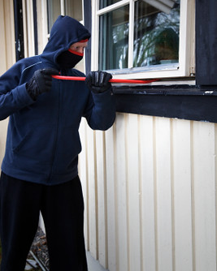
Problem
Homes, businesses, and facilities become vulnerable at night to break-ins or intrusions
On average, 3,062 burglaries happen in the U.S. every day
Full security systems are:
Semi-permanent
Costly
Can take time to install
Notes:
Exactly how dylan keeps about “what's the problem”

Slide 3

Project Topic
This project aims to design and build a robot for use in the monitoring of indoor spaces
Robot will be capable of:
Autonomous movement
Navigation of a building or room without the need for human control
Utilize sensors to detect loud noises or the presence of a person
Flash lights and play an alarm sound when disturbance is detected
Get signal from remote control to turn the system on and off
Notes:
S

Slide 4
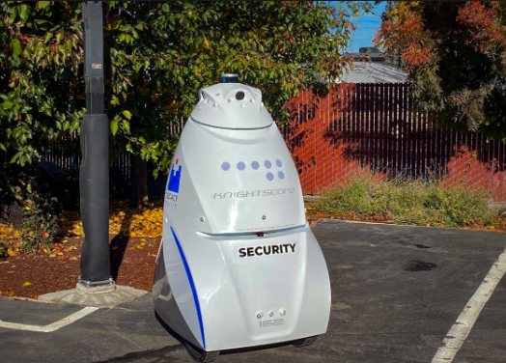
Background Information
One example of security robot is from Knightscope Robotics, named the K5 ASR
Functions in indoor and outdoor environments
Can detect environmental anomalies or concealed weapons
Annual Cost is $60,000 to $70,000
Image from: https://www.knightscope.com/products/k5
Notes:
What we already read about it
Stuff thats within the market.
How our products is better than others.
Lit review stuff

Slide 5
Autonomous Threat Detection and Alarm Security Robot
or
‘Home Owl’
Notes:
“Autonomous Threat Detection and Alarm Security Robot” is too long and she was coming up with an acronym on the spot
Sit down and give it a name
Literally discuss about the name and how we came to it and why we chose this name

Slide 6
References
Pelchen, Lexie. “Surprising Home Burglary Facts and Stats.” Forbes, Forbes Magazine, 30 Apr. 2024, www.forbes.com/home-improvement/home-security/home-invasion-statistics/#:~:text=On%20average%2C%203%2C062%20burglaries%20happen,when%20nobody%20was%20at%20home.
“K5 Fully Autonomous Outdoor Security Robot.” K5 Fully Autonomous Outdoor Security Robot. Accessed 26 Sept. 2024. www.knightscope.com/products/k5
Notes:
Work cited of the slides; articles, websites, and other sources

